Slide 1
ELECTRICAL SCIENCE-1 (15B11EC111) UNIT-2 Lecture-2

Slide 2
Topics to be Discussed
Source transformation
Practice Problem
References

Slide 3
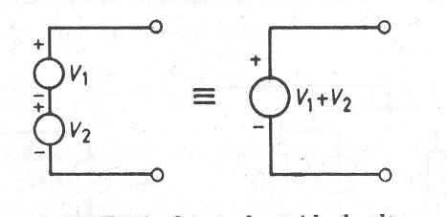
Ideal Voltage Sources Connected in Series

Slide 4
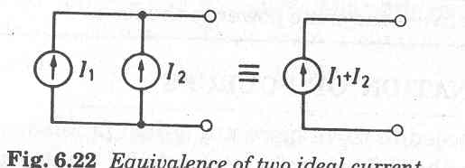
Ideal Current Sources Connected in Parallel

Slide 5
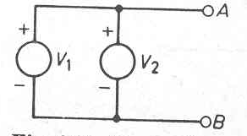
Ideal Voltage Sources Connected in Parallel
Such Connection is NOT permitted.

Slide 6
Source Transformation
A practical current source can be converted into its equivalent practical voltage source, and vice versa.
This conversion is valid only for the external load connected across the terminals of the source.

Slide 7
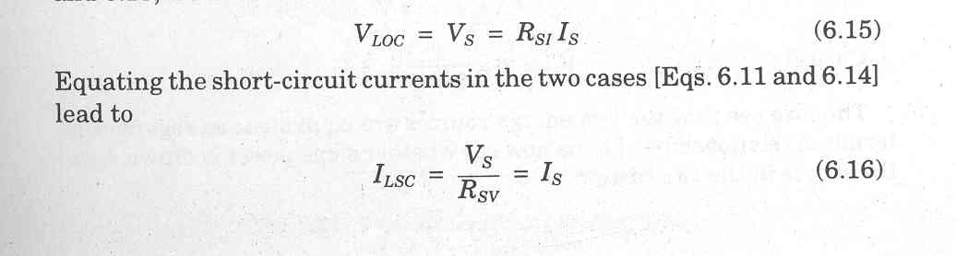

Equivalence between Voltage Source and Current Source
Two sources would be equivalent if they produce identical values of V_{L} and I_{L}, when they are connected across the same load.

Slide 8
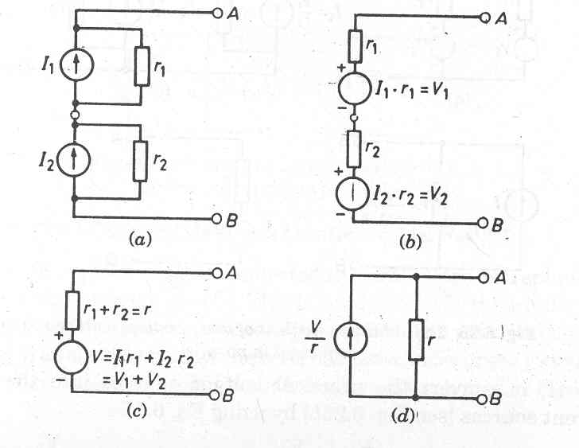
Practical Current Sources Connected in Series

Slide 9
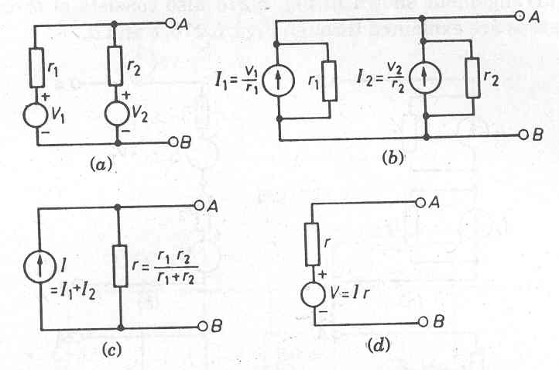
Practical Voltage Sources Connected in Parallel

Slide 10
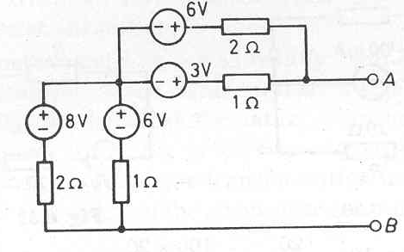
Problem
Reduce the network shown in figure to its simplest possible form by using source transformation.

Slide 11
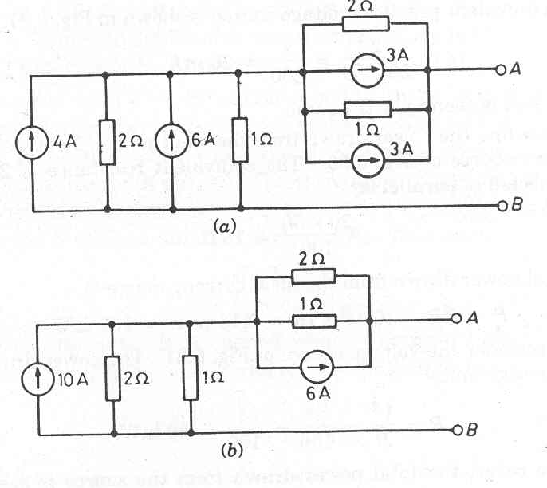
Solution

Slide 12
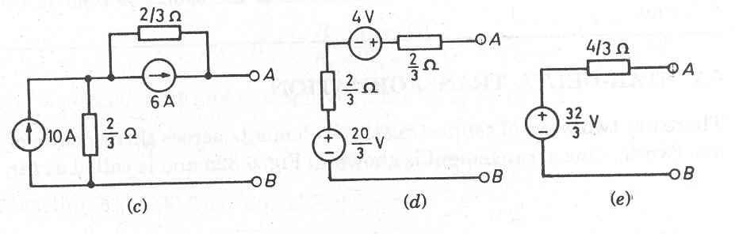

Slide 13
REFERENCES
[1] R.C. Dorf and James A. Svoboda, “Introduction to Electric Circuits”, 9th ed, John Wiley & Sons, 2013.

